Slide 1
CPE 150: Introduction to Programming
Course Overview
Ahmed Tamrawi
Copyright notice: care has been taken to use only those web images deemed by the instructor to be in the public domain. If you see a copyrighted image on any slide and are the copyright owner, please contact the instructor. It will be removed.

Slide 2
B.Eng. Computer Engineering
(Class of 2007)
M.Sc. Computer Engineering
(Class of 2011)
Ph.D.. Computer Engineering
(Class of 2016)

Slide 3
Secure Programming
Static Program Analysis
Data & Pattern Mining
Software Analysis & Security
Bug finding and Malware detection
Build System Analysis
Abstractions and Symbolic Evaluations

Slide 4
YOU
Name
Year in undergraduate program.
Something about you
Food you like.
Programming languages you used.
Open source projects you contributed to.
What do you think of this course?
What are your goals after graduation?

Slide 5
Goal of the Class

Slide 6
We need to learn programming languages to instruct the computer to use these basic operations to perform complex computations

Slide 7
This is a course to teach you how to write computer programs to be able to develop algorithms that solve real-world problems.

Slide 8
We will gain knowledge in program comprehension and debugging in addition to coding skills

Slide 9
By the end of the course, you will be confidently able to write <500 LOC programs without any problems – This is of course if you pay attention, try the examples throughout the course and implement the Lab tasks on your own

Slide 10
Syllabus

Slide 11
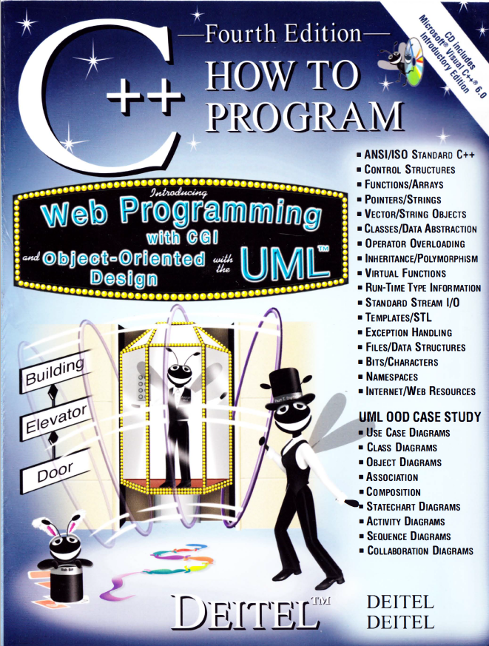
Official Textbook

Slide 12
Grading Policy
First Exam | 15% | 7.5% (Program Comprehension + Debugging) 7.5% (Coding Skills)
Second Exam | 15% | 7.5% (Program Comprehension + Debugging) 7.5% (Coding Skills)
Final Exam | 35% | 17.5% (Program Comprehension + Debugging) 17.5% (Coding Skills)
65%
Theory
Tasks | 7% | Due in Lab, cheating results on ZERO
Quizzes | 10.5% | Every two labs, the first 10-15 minutes of the Lab, Absence results on ZERO (NO MAKEUP)
Mid Exam | 7% | Tests your program comprehension, debugging and coding skills.
Final Exam | 10.5% | Tests your program comprehension, debugging and coding skills.
35%
Lab
50% will be on coding skills

Slide 13
Chapter 1: Introduction to Computers and C++ Programming
1.1 Introduction 1.2 What is a Computer? 1.6 Machine Languages, Assembly Languages, and High-Level Languages 1.14 Basics of a Typical C++ Environment 1.21 A Simple Program: Printing a Line of Text 1.22 Another Simple Program: Adding Two Integers 1.23 Memory Concepts 1.24 Arithmetic

Slide 14
Chapter 2: Control Structures
2.1 Introduction
2.2 Algorithms
2.3 Pseudocode
2.4 Control Structures
2.5 if Selection Structure
2.6 if/else Selection Structure
2.7 while Repetition Structure
2.8 Counter-Controlled Repetition
2.9 Sentinel-Controlled Repetition
2.10 Nested Control Structures
2.11 Assignment Operators
2.12 Increment and Decrement Operators
2.13 Essentials of Counter-Controlled Repetition
2.14 for Repetition Structure
2.15 Examples Using the for Structure
2.16 switch Multiple-Selection Structure
2.17 do/while Repetition Structure
2.18 break and continue Statements
2.19 Logical Operators
2.20 Confusing Equality (==) and Assignment (=) Operators
2.21 Structured-Programming Summary

Slide 15
Chapter 3: Functions
3.1 Introduction
3.2 Program Components in C++
3.3 Math Library Functions
3.4 Functions
3.5 Function Definitions
3.6 Function Prototypes
3.7 Header Files
3.8 Random Number Generation
3.9 Example: A Game of Chance and Introducing enum
3.10 Storage Classes
3.11 Scope Rules
3.12 Recursion
3.13 Example Using Recursion: The Fibonacci Series
3.14 Recursion vs. Iteration
3.15 Functions with Empty Parameter Lists
3.16 Inline Functions 3.17 References and Reference Parameters 3.18 Default Arguments 3.19 Unary Scope Resolution Operator 3.20 Function Overloading 3.21 Function Templates
18.9 Character-Handling Library

Slide 16
Chapter 4: Arrays
4.1 Introduction 4.2 Arrays
4.3 Declaring Arrays
4.4 Examples Using Arrays
4.5 Passing Arrays to Functions
4.6 Sorting Arrays
4.7 Case Study: Computing Mean, Median and Mode Using Arrays
4.8 Searching Arrays: Linear Search and Binary Search
4.9 Multiple-Subscripted Arrays

Slide 17
Chapter 5: Pointers and Strings
5.1 Introduction 5.2 Pointer Variable Declarations and Initialization 5.3 Pointer Operators 5.4 Calling Functions by Reference 5.5 Using const with Pointers 5.6 Bubble Sort Using Pass-by-Reference 5.7 Pointer Expressions and Pointer Arithmetic 5.8 Relationship Between Pointers and Arrays 5.9 Arrays of Pointers 5.10 Case Study: Card Shuffling and Dealing Simulation 5.11 Function Pointers 5.12 Introduction to Character and String Processing 5.12.1 Fundamentals of Characters and Strings 5.12.2 String Manipulation Functions of the String-Handling Library
5.X Dynamic Memory Allocation

Slide 18
Chapter 6: Classes and Data Abstraction
6.1 Introduction 6.2 Structure Definitions 6.3 Accessing Structure Members 6.4 Implementing a User-Defined Type Time with a struct 6.5 Implementing a Time Abstract Data Type with a class 6.6 Class Scope and Accessing Class Members 6.7 Separating Interface from Implementation 6.8 Controlling Access to Members

Slide 19
Chapter 14: File Processing
14.1 Introduction
14.2 The Data Hierarchy
14.3 Files and Streams
14.4 Creating a Sequential-Access File
14.5 Reading Data from a Sequential-Access File

Slide 20
Chapter 18: Bits, Characters, Strings and Structures
18.7 Bitwise Operators

